Slide 1
7-Person Mechanics Line of Scrimmage

Slide 2
Open Floor
Burning questions
Curiosities
Notes:
(3 min)

Slide 3
What you need to do to succeed
Nothing new! 7-person narrows your focus
Run the game, like normal
Avoid pitfalls
Administrative errors
Down errors
Mis-enforced penalties
Clock errors
Notes:
(2 min)

Slide 4
What you need to do to excel
Preparation = Confidence
Deep official = support
You lead the dance
Stay clock focused
Understand the production
Notes:
(2 min)
Don’t do much new in terms of preparation. Hopefully you’re preparing thoroughly on a week to week basis, and if so, you got this spot because of that preparation, keep it up
The production – being where you’re supposed to be and having the piece of info that the crew and the audience needs, when they need it

Slide 5
The Big Differences: 5 vs 7
Kicking plays
Free kicks
Scrimmage kicks
Field goals and Trys
Passing Plays
Initial responsibility
Area of responsibility
Reverse Mechanics
Be slow, then fast if you need
Notes:
(2 min)

Slide 6
The Big Differences: Kicking Plays
Free kicks: Deep
My meditation: FFPC – Formation, Fair catch, Possession, Clock
Slow to stationary – just like 5-person
Inside out vision
Free kicks: Anticipated onside
Deep is going deep
My meditation: Ball, Touching, Blocks, Clock
Also be alert for fair catch signals
DON’T MOVE!
Notes:
(6 mins)
1 play from endzone view with laser pointer and/or DVS arrows

Slide 7
The Big Differences: Kicking Plays
Scrimmage kicks: Physical Mechanics
Bad snap coverage – facing R (signal?)
Both on the LOS until ball is gone
Move downfield
You’re a deep!
Scrimmage kicks: Visual Mechanics
Know your eligibles
Quick glance at gunners if pressed
Stay with bad color – blocked into?
2nd wave all the way down
You’re a deep!
Notes:
(5 mins)
1 play from sideline view

Slide 8
The Big Differences: Kicking Plays
Field goals and Trys
Both on the LOS
B GL responsibility 20 and in (signal?)
A GL responsibility everywhere
Bad snap coverage – facing R (signal?)
Know your eligibles
Wings and ends
It’s just a scrimmage kick
Notes:
(2 mins)

Slide 9
The Big Differences: Passing Plays
Initial responsibility (IR) – Mechs Manual, OR
Initial responsibility – The Easy Version
Quads: Let them declare
Trips: H or L have #2
5-Wide: H and L each have #2
Doubles: H has #2
Anything but trips to L side: L has back
2+ backs and no trips: H and L both have backs
Notes:
(5 mins)
Video?

Slide 10
The Big Differences: Passing Plays
Visual Mechanics: Area of responsibility (AR)
5-person figure
7-person figure
Primary AR is “the belt”
Vision is no longer divided
Physical Mechanics (what do we sometimes do on pass plays?)
Stay on the LOS
Sideline Coordination (include my pregame convo checklist)
save for time w/ deeps and run by Jace and Michael
Notes:
(3 min)

Slide 11
The Big Differences: Reverse Mechanics
Be slow, then fast if you need
Give a count or two
Natural, efficient coverage
Become the deep official
Notes:
(3 mins)

Slide 12
The Production
Give the game what it’s expecting
Do all the basics
Penalty administration
Penalty enforcement
Everything else
Notes:
(5 mins)

Slide 13
Awareness, Courage, Communication
The game is going to need you to step up at some point – Will you be ready? Will you have the courage to inject/interject? Can you communicate what you have?
Pick someone up off of a foul (strong opinions)
Clock error (positive knowledge)
Mis-enforced penalty (ask the right question)
Notes:
(5 mins)
Pick someone up off of a foul – Deep has OH-TD on a TE in front of a sweep run. You were at the same spot and you saw the block and it’s an overpower/pancake
Clock error – Previous play was incomplete pass, clock stopped with 0:32. Next play is an incomplete pass, clock is still at 0:32
Avoid mis-enforcements by going thru the proper process 1st and foremost, BUT, 10 yard penalty from the spot of the foul. L you do your check and they only walked 8, the flag has been picked up and the offense is breaking the huddle

Slide 14
7-person Mechanics: General Overview
Pregame
L: No duties to clock operator, join H with chains or enjoy freedom
H: No change
Coin Toss
No change
Free Kick – Deep: already covered
Free Kick – Anticipated Onside: already covered
Scrimmage Plays – Goal Line Mechanics
Progress to the 2 if starting outside the 7 – communicate!
First move to the GL at the 7 and in – communicate!
Notes:
(3 mins)

Slide 15
7-person Mechanics: General Overview
Scrimmage Plays – Reverse Goal Line Mechanics
No change?
Signal?
Scrimmage Kicks: already covered
General Duties
Down, distance and clock status
Penalty Enforcement
Don’t let the U leave before you’re at the spot
Share the spot with the crew
Measurements
Bring and check the clip
Notes:
(3 mins)

Slide 16
7-person Mechanics: Sideline Coordination
Deep Role is to Support the Sideline
IR Switches
OPI Coordination
Sideline Catches
Spots Near the 2
Pylon Plays
Explosive Play Spots
Reverse Mechanics
Coach Communication
Notes:
(10-15 mins)
IR Switches (Default – Week 12 – Play 133)
OPI – 2023 – SLC – Wk 10 – LU v TXAMC – Play 27
2 spots – 2023 – SLC – Wk 4 – Lamar v Lincoln – Play 24

Slide 17
5-Person Areas of Responsibility
H
U
LOS has sideline and belt
~10% of the field has overlap
B
R
Back to slides
L

Slide 18
5-Person Areas of Responsibility
H
S
U
LOS has belt
~50% of the field has overlap
B
R
Back to slides
L
F

Slide 19
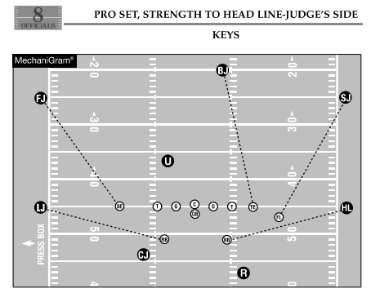
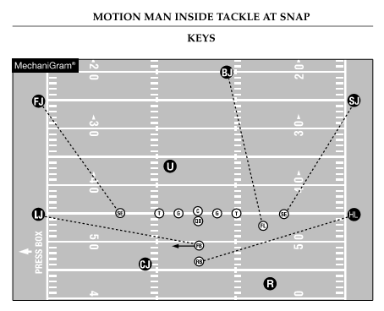
Back to slides

Slide 20
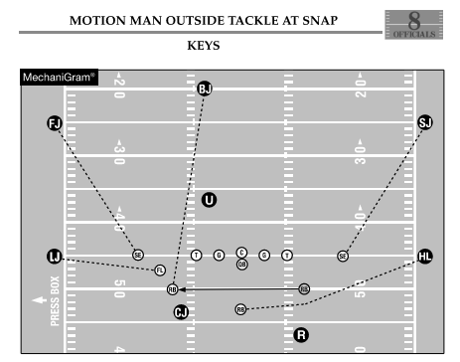
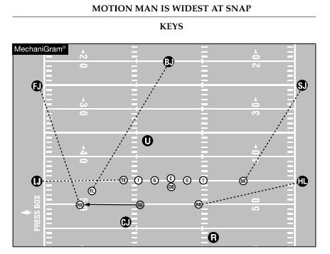
Back to slides

Slide 21
Back to slides

Slide 22
Back to slides

Slide 23
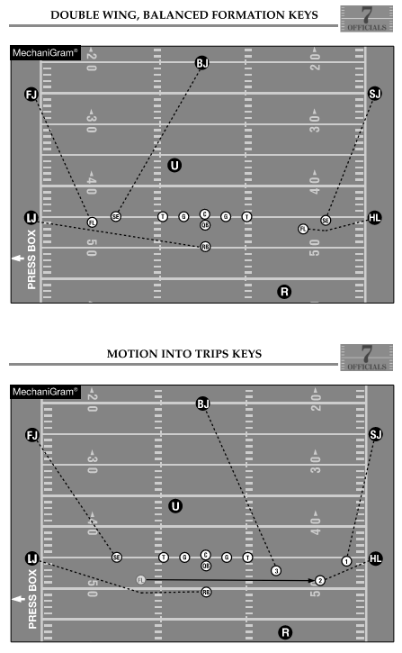
Back to slides

